Slide 1


MALLA REDDY COLLEGE OF ENGINEERING & TECHNOLOGY (AUTONOMUS INSTITUTION –UGC, GOVT. OF INDIA) Affiliated to JNTUH; Approved by AICTE, NBA-Tier 1 & NAAC with A-GRADE| ISO 9001:2015
CRYPTO CURRENCY PRICE PREDICTION
Team Members Details
1.Md.Afsar – 22N31A66B5
2.Md.Aman Khan – 22N31A66B7
3.M.Goutham – 22N31A66B0
III Year B.Tech-II Semester – CSE (AIML)
Under the Guidance of
Mr.S Venkateswara Raju
Associate Professor
B.Tech III Year – II Sem | Dept of Computational Intelligence| Application Development – II | Project Review

Slide 2

Agenda
MALLA REDDY COLLEGE OF ENGINEERING AND TECHNOLOGY
Abstract
Introduction
Existing System
Proposed System
System Architecture
Requirements Specifications
System Models
Implementation & Testcases
Conclusion & Future Enhancement
References
B.Tech III Year – II Sem | Dept of Computational Intelligence| Application Development – II | Project Review

Slide 3
Abstract
MALLA REDDY COLLEGE OF ENGINEERING AND TECHNOLOGY
The "Crypto currency price prediction " is a web application designed to predict the future prices of selected cryptocurrencies. Traditional methods such as technical analysis, which involves studying historical price charts and trading volumes. The proposed system utilizes historical price data obtained from yahoo finance and implements a linear regression model for predicting. The application provides interactive visualizations of both raw data and predicted prices using plotly. Users can select from a range of cryptocurrencies and specify the number of days for which they want predictions.
B.Tech III Year – II Sem | Dept of Computational Intelligence| Application Development – II | Project Review

Slide 4
Introduction
MALLA REDDY COLLEGE OF ENGINEERING AND TECHNOLOGY
Cryptocurrency has emerged as a popular investment avenue, characterized by its decentralized nature and potential for high returns. However, the volatile nature of the market poses challenges for investors seeking to make informed decisions. In response to market volatility, there's a growing demand for predictive tools that can predict cryptocurrency prices accurately. These tools empower investors with valuable insights, enabling them to mitigate risks and maximize returns.
B.Tech III Year – II Sem | Dept of Computational Intelligence| Application Development – II | Project Review

Slide 5
Existing System
MALLA REDDY COLLEGE OF ENGINEERING AND TECHNOLOGY
Challenges in the existing system:-Traditional methods such as technical analysis, which involves studying historical price charts and trading volumes, often fall short in predicting highly volatile and unpredictable cryptocurrency prices.
Limitations of traditional analysis:- Fundamental analysis, which examines intrinsic value by analyzing factors like market demand, adoption rate, and regulatory news, is unreliable due to the rapidly evolving nature of the cryptocurrency ecosystem.
Limitations of technical analysis :- Technical analysis primarily focuses on short-term price movements and patterns, which may not provide reliable long- term predictions in a highly volatile market like cryptocurrency.
B.Tech III Year – II Sem | Dept of Computational Intelligence| Application Development – II | Project Review

Slide 6
Proposed System
MALLA REDDY COLLEGE OF ENGINEERING AND TECHNOLOGY
The proposed cryptocurrency price prediction addresses the shortcomings of the existing system by leveraging machine learning algorithms to predict future cryptocurrency prices.
Our system integrates real-time data, features a user-friendly interface, offers customization, assesses accuracy, and includes currency conversion, empowering users to make informed decisions.
The proposed cryptocurrency price prediction improves on current systems by using machine learning algorithms to predict future cryptocurrency prices.
B.Tech III Year – II Sem | Dept of Computational Intelligence| Application Development – II | Project Review

Slide 7
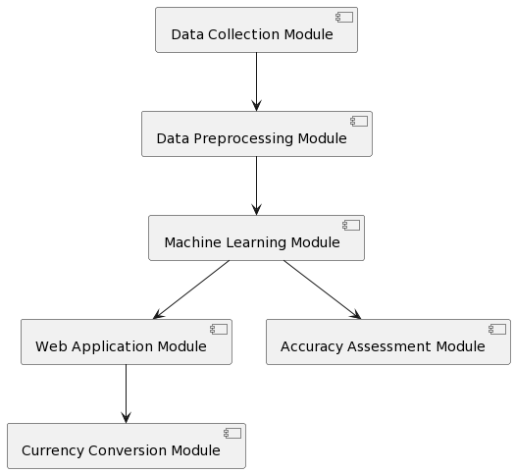
System Architecture
MALLA REDDY COLLEGE OF ENGINEERING AND TECHNOLOGY
B.Tech III Year – II Sem | Dept of Computational Intelligence| Application Development – II | Project Review

Slide 8
Requirements Specification
MALLA REDDY COLLEGE OF ENGINEERING AND TECHNOLOGY
B.Tech III Year – II Sem | Dept of Computational Intelligence| Application Development – II | Project Review

Slide 9
MALLA REDDY COLLEGE OF ENGINEERING AND TECHNOLOGY
Software Requirement Specifications (SRS)
Operating System: Windows
Coding Language: Python 3.7
Platform : Jupyter Notebook
Modules : Numpy , Pandas , Matplotlib , Scikit-learn
Database : MySQL
Framework : Streamlit
B.Tech III Year – II Sem | Dept of Computational Intelligence| Application Development – II | Project Review

Slide 10
Hardware Requirement Specifications (HRS)
MALLA REDDY COLLEGE OF ENGINEERING AND TECHNOLOGY
RAM: 8GB and above
Hard disk: 256 GB or above
Processor: intel i5 or above
B.Tech III Year – II Sem | Dept of Computational Intelligence| Application Development – II | Project Review

Slide 11
MALLA REDDY COLLEGE OF ENGINEERING AND TECHNOLOGY
System Models
(UML Diagrams)
B.Tech III Year – II Sem | Dept of Computational Intelligence| Application Development – II | Project Review

Slide 12
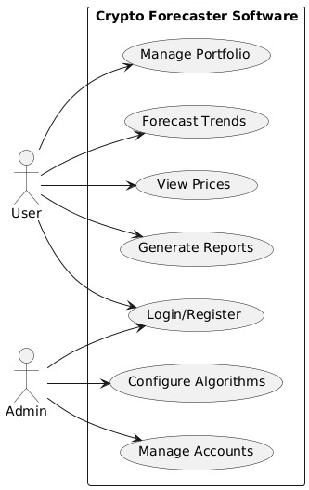
Use Case Diagram
MALLA REDDY COLLEGE OF ENGINEERING AND TECHNOLOGY
B.Tech III Year – II Sem | Dept of Computational Intelligence| Application Development – II | Project Review

Slide 13
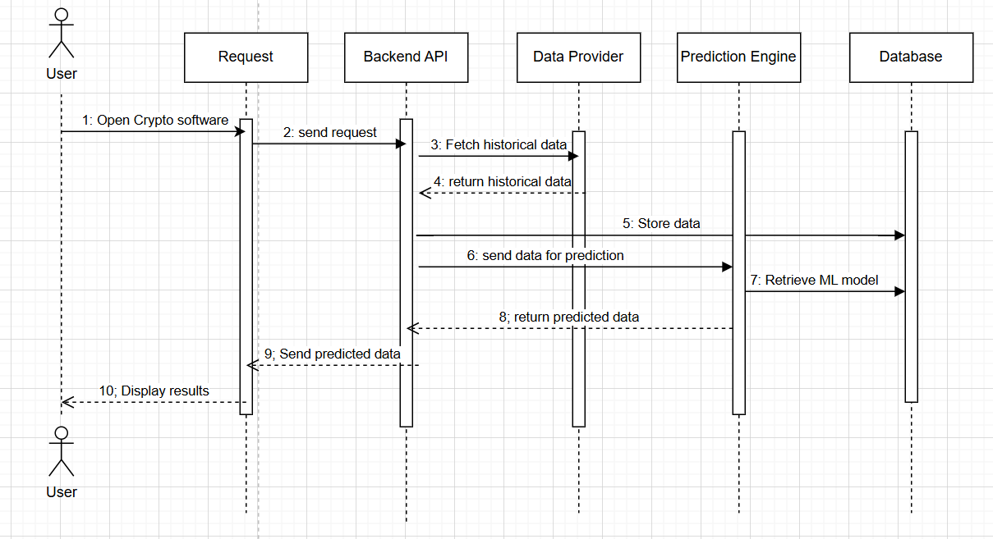
Sequence Diagram
MALLA REDDY COLLEGE OF ENGINEERING AND TECHNOLOGY
B.Tech III Year – II Sem | Dept of Computational Intelligence| Application Development – II | Project Review

Slide 14
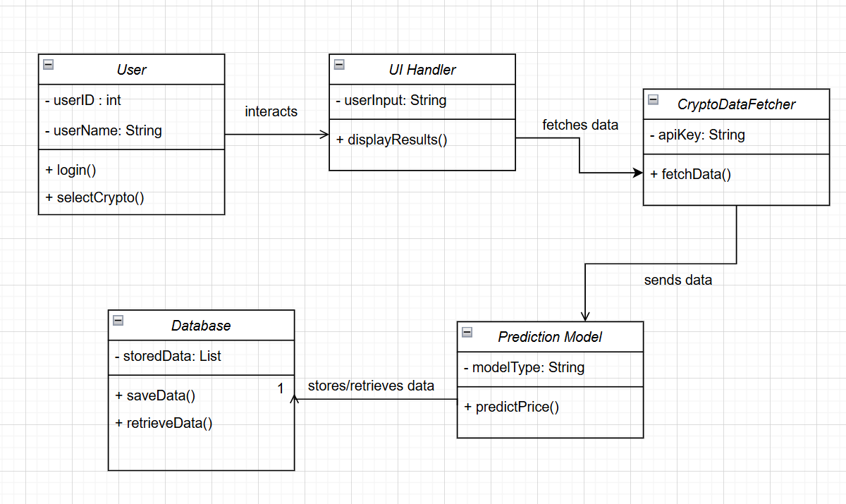
Class Diagram
MALLA REDDY COLLEGE OF ENGINEERING AND TECHNOLOGY
B.Tech III Year – II Sem | Dept of Computational Intelligence| Application Development – II | Project Review

Slide 15
MALLA REDDY COLLEGE OF ENGINEERING AND TECHNOLOGY
Implementation & Testcases
B.Tech III Year – II Sem | Dept of Computational Intelligence| Application Development – II | Project Review

Slide 16
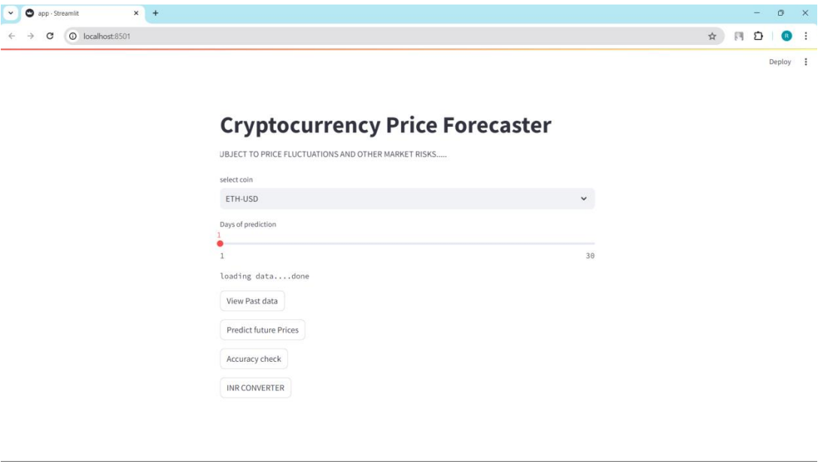
MALLA REDDY COLLEGE OF ENGINEERING AND TECHNOLOGY
B.Tech III Year – II Sem | Dept of Computational Intelligence| Application Development – II | Project Review

Slide 17
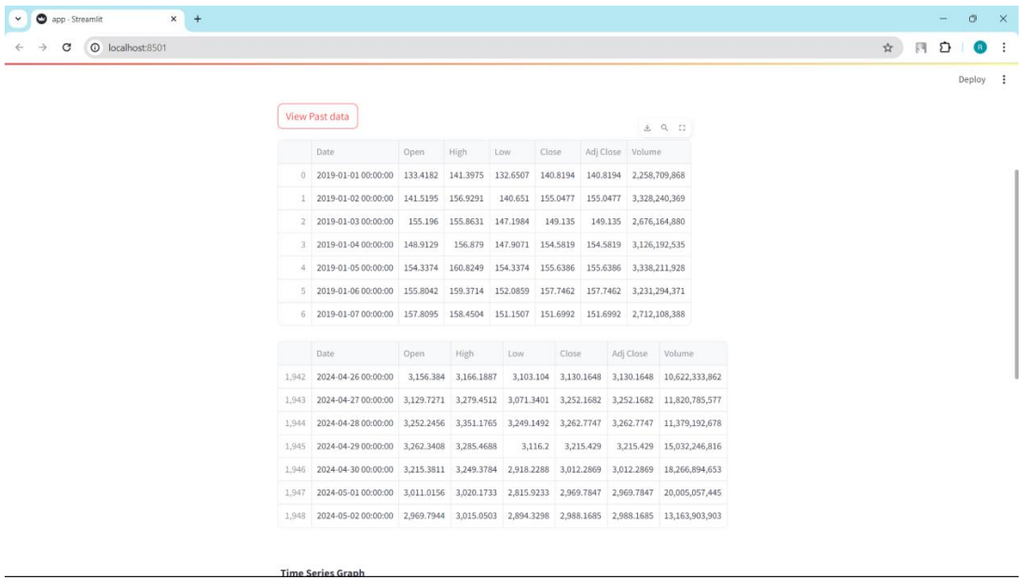
MALLA REDDY COLLEGE OF ENGINEERING AND TECHNOLOGY
B.Tech III Year – II Sem | Dept of Computational Intelligence| Application Development – II | Project Review

Slide 18
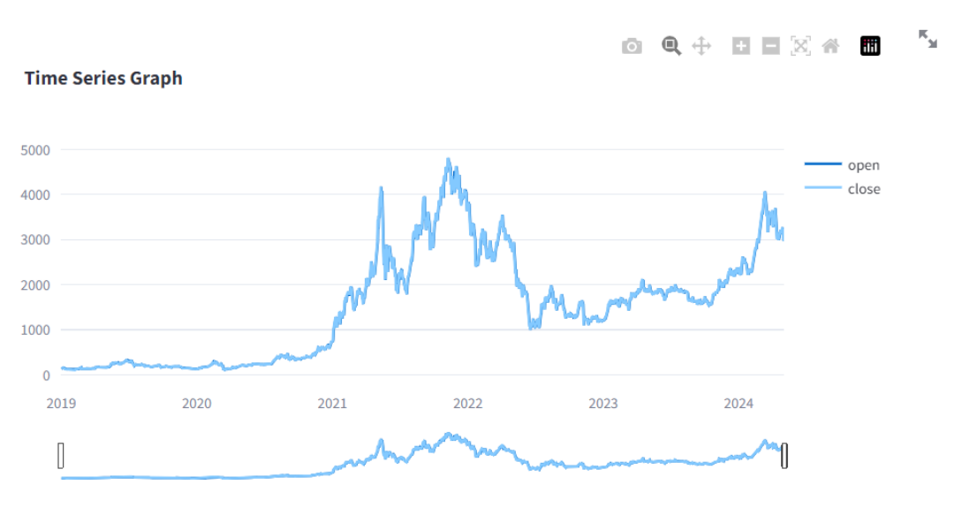
MALLA REDDY COLLEGE OF ENGINEERING AND TECHNOLOGY
B.Tech III Year – II Sem | Dept of Computational Intelligence| Application Development – II | Project Review

Slide 19
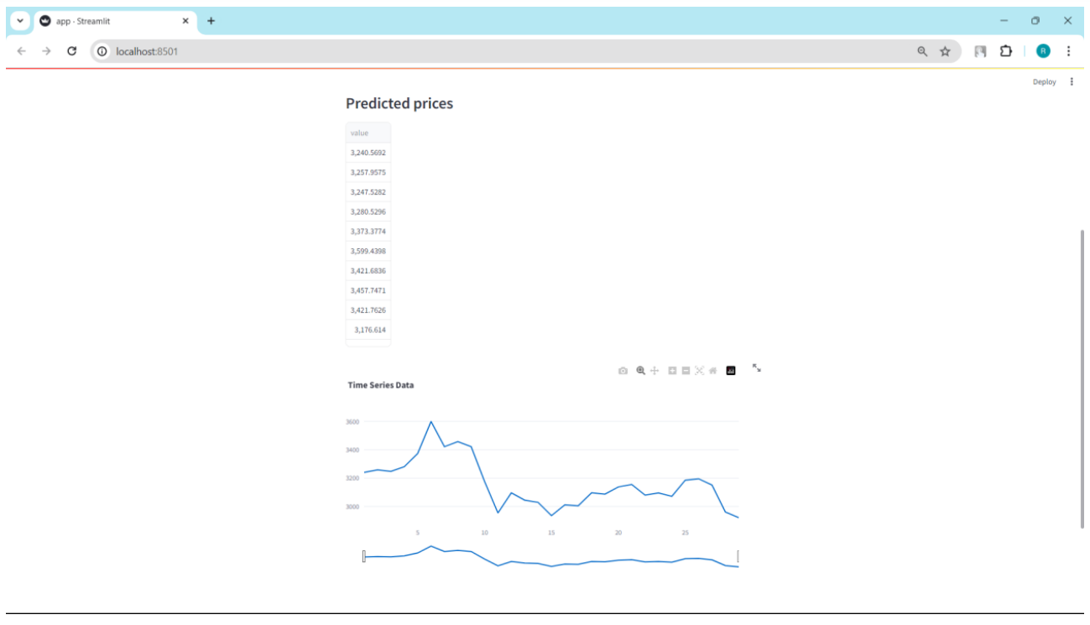
MALLA REDDY COLLEGE OF ENGINEERING AND TECHNOLOGY
B.Tech III Year – II Sem | Dept of Computational Intelligence| Application Development – II | Project Review

Slide 20
Testing
MALLA REDDY COLLEGE OF ENGINEERING AND TECHNOLOGY
Software testing is a crucial component of software quality assurance, ensuring that a software product meets its specified requirements, functions correctly, and is free of defects. It aims to verify correctness, validate functionality, identify bugs, and assess performance, security, and usability. Software testing is a critical element of software quality assurance and represents the ultimate review of specification, design and code generation. By detecting issues early in the development process, software testing reduces costs, improves product quality, and ensures a reliable user experience. It involves various stages, including test planning, design, execution, defect tracking, and closure. Testing can be manual or automated and covers different levels such as unit, integration, system, acceptance, and regression testing.
B.Tech III Year – II Sem | Dept of Computational Intelligence| Application Development – II | Project Review

Slide 21
Conclusion & Future Enhancements
MALLA REDDY COLLEGE OF ENGINEERING AND TECHNOLOGY
The Cryptocurrency Price Forecaster developed in this project provides users with a platform to predict future prices of various cryptocurrencies based on historical data. Leveraging the power of machine learning, particularly Linear Regression, users can gain insights into potential price trends, aiding in their investment decisions in the volatile cryptocurrency market. The user-friendly interface, built using Streamlit, offers an intuitive experience, allowing users to easily select cryptocurrencies, specify the prediction horizon, and visualize predicted prices. Explore more sophisticated machine learning algorithms, such as Random Forest, Gradient Boosting, or LSTM networks, to improve prediction accuracy and capture complex price patterns. Incorporate additional features, such as trading volume, market sentiment, or technical indicators, to enhance the predictive capabilities of the model. Implement ensemble methods, such as stacking or blending, to combine predictions from multiple models and achieve better overall performance.
B.Tech III Year – II Sem | Dept of Computational Intelligence| Application Development – II | Project Review

Slide 22
References
MALLA REDDY COLLEGE OF ENGINEERING AND TECHNOLOGY
[1] Predicting Cryptocurrency Prices Using Machine Learning Techniques: Journal of Financial Engineering. - by Smith, John.
[2] An Introduction to Cryptocurrency Forecasting Models: Data Science Review - by Jones, Emily
[3] Cryptocurrency Market Analysis: Trends, Challenges, and Opportunities : Journal of Financial Technology - by Tom Rath
B.Tech III Year – II Sem | Dept of Computational Intelligence| Application Development – II | Project Review

Slide 23
Thank you
MALLA REDDY COLLEGE OF ENGINEERING AND TECHNOLOGY
1.Md.Afsar – 22N31A66B5
2.Md.Aman Khan – 22N31A66B7
3.M.Goutham – 22N31A66B0
B.Tech III Year – II Sem | Dept of Computational Intelligence| Application Development – II | Project Review

